Slide 1
Team Maven
Matt Yee Kevin Li Micheal Chung
Michael Thompson Budi P Chen Benjamin De Jager
Isiah Santala Joshua C Elder

Slide 3
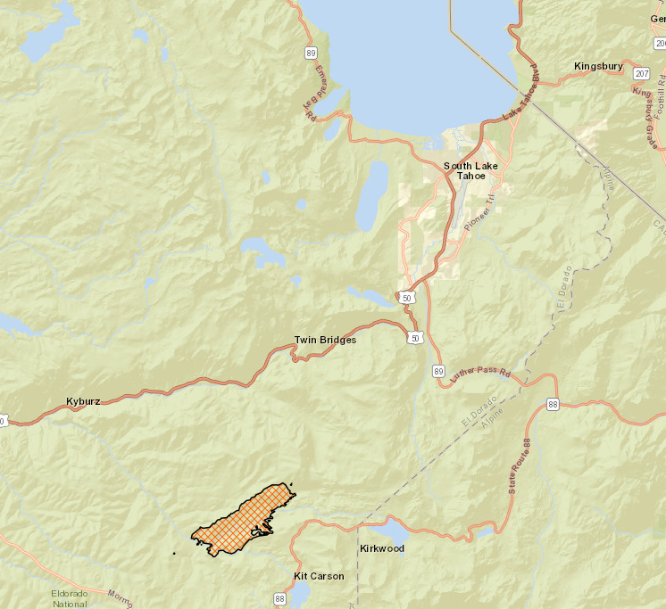
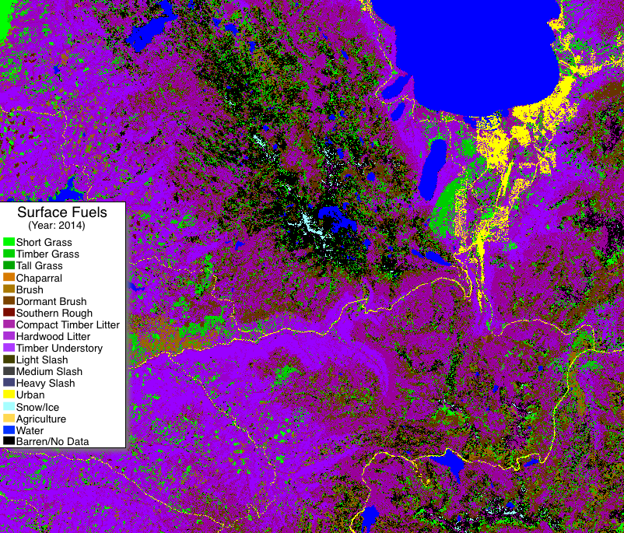
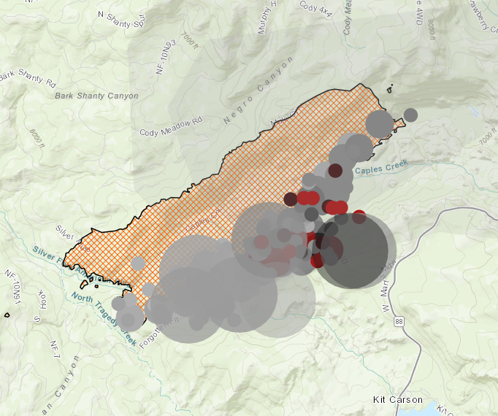
Propagation – How Fires Spread
There are many, many, many, many variables…
Let’s look at two ways that fires can spread
Radiated heat increasing temperature of surrounding fuel source

Slide 4
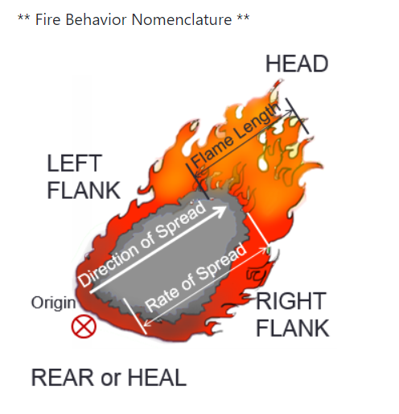
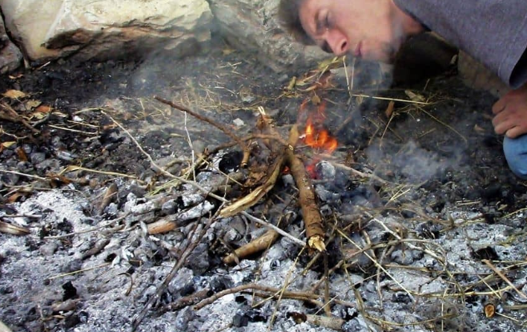
Propagation – How Fires Spread (cont.)
Wind matters too, right?
Yes, but…..is it helping or hurting?

Slide 5
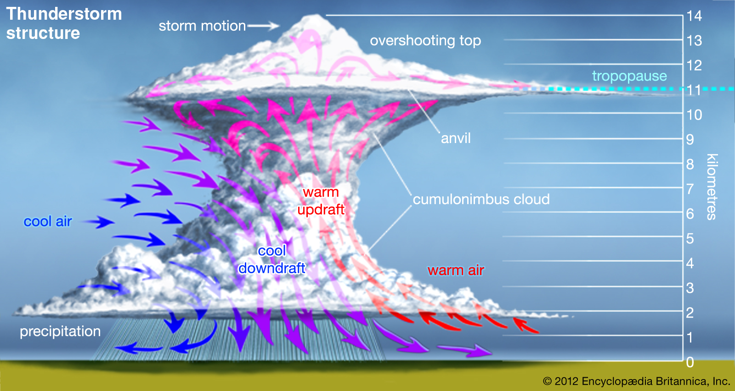
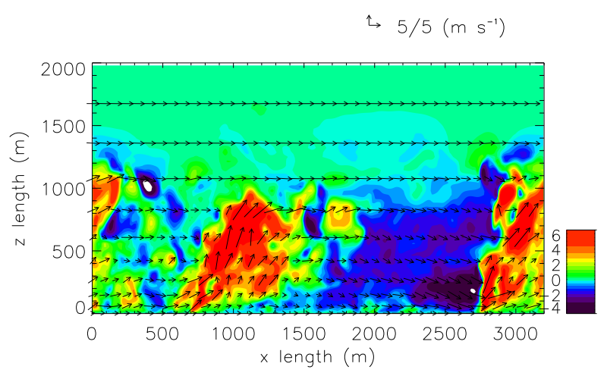
Winds Are Pushing AND Providing Oxygen…
It’s like a thunderstorm…
…but it’s on fire!!!

Slide 6
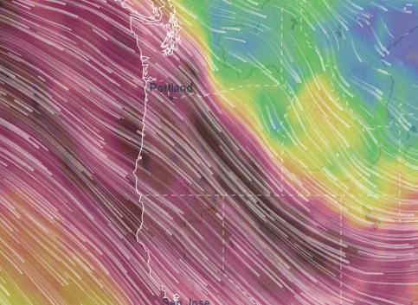
The Bigger the Fire…
The higher levels of winds that will act upon it
15,000 ft @ 80 mph or more

Slide 7
We Started With a Model
First version is designed to show radiating heat

Slide 8
We Started With a Model
Then we overlaid wind data on top

Slide 9
We Started With a Model
Future work will have different layers of wind and model vertical development

Slide 10
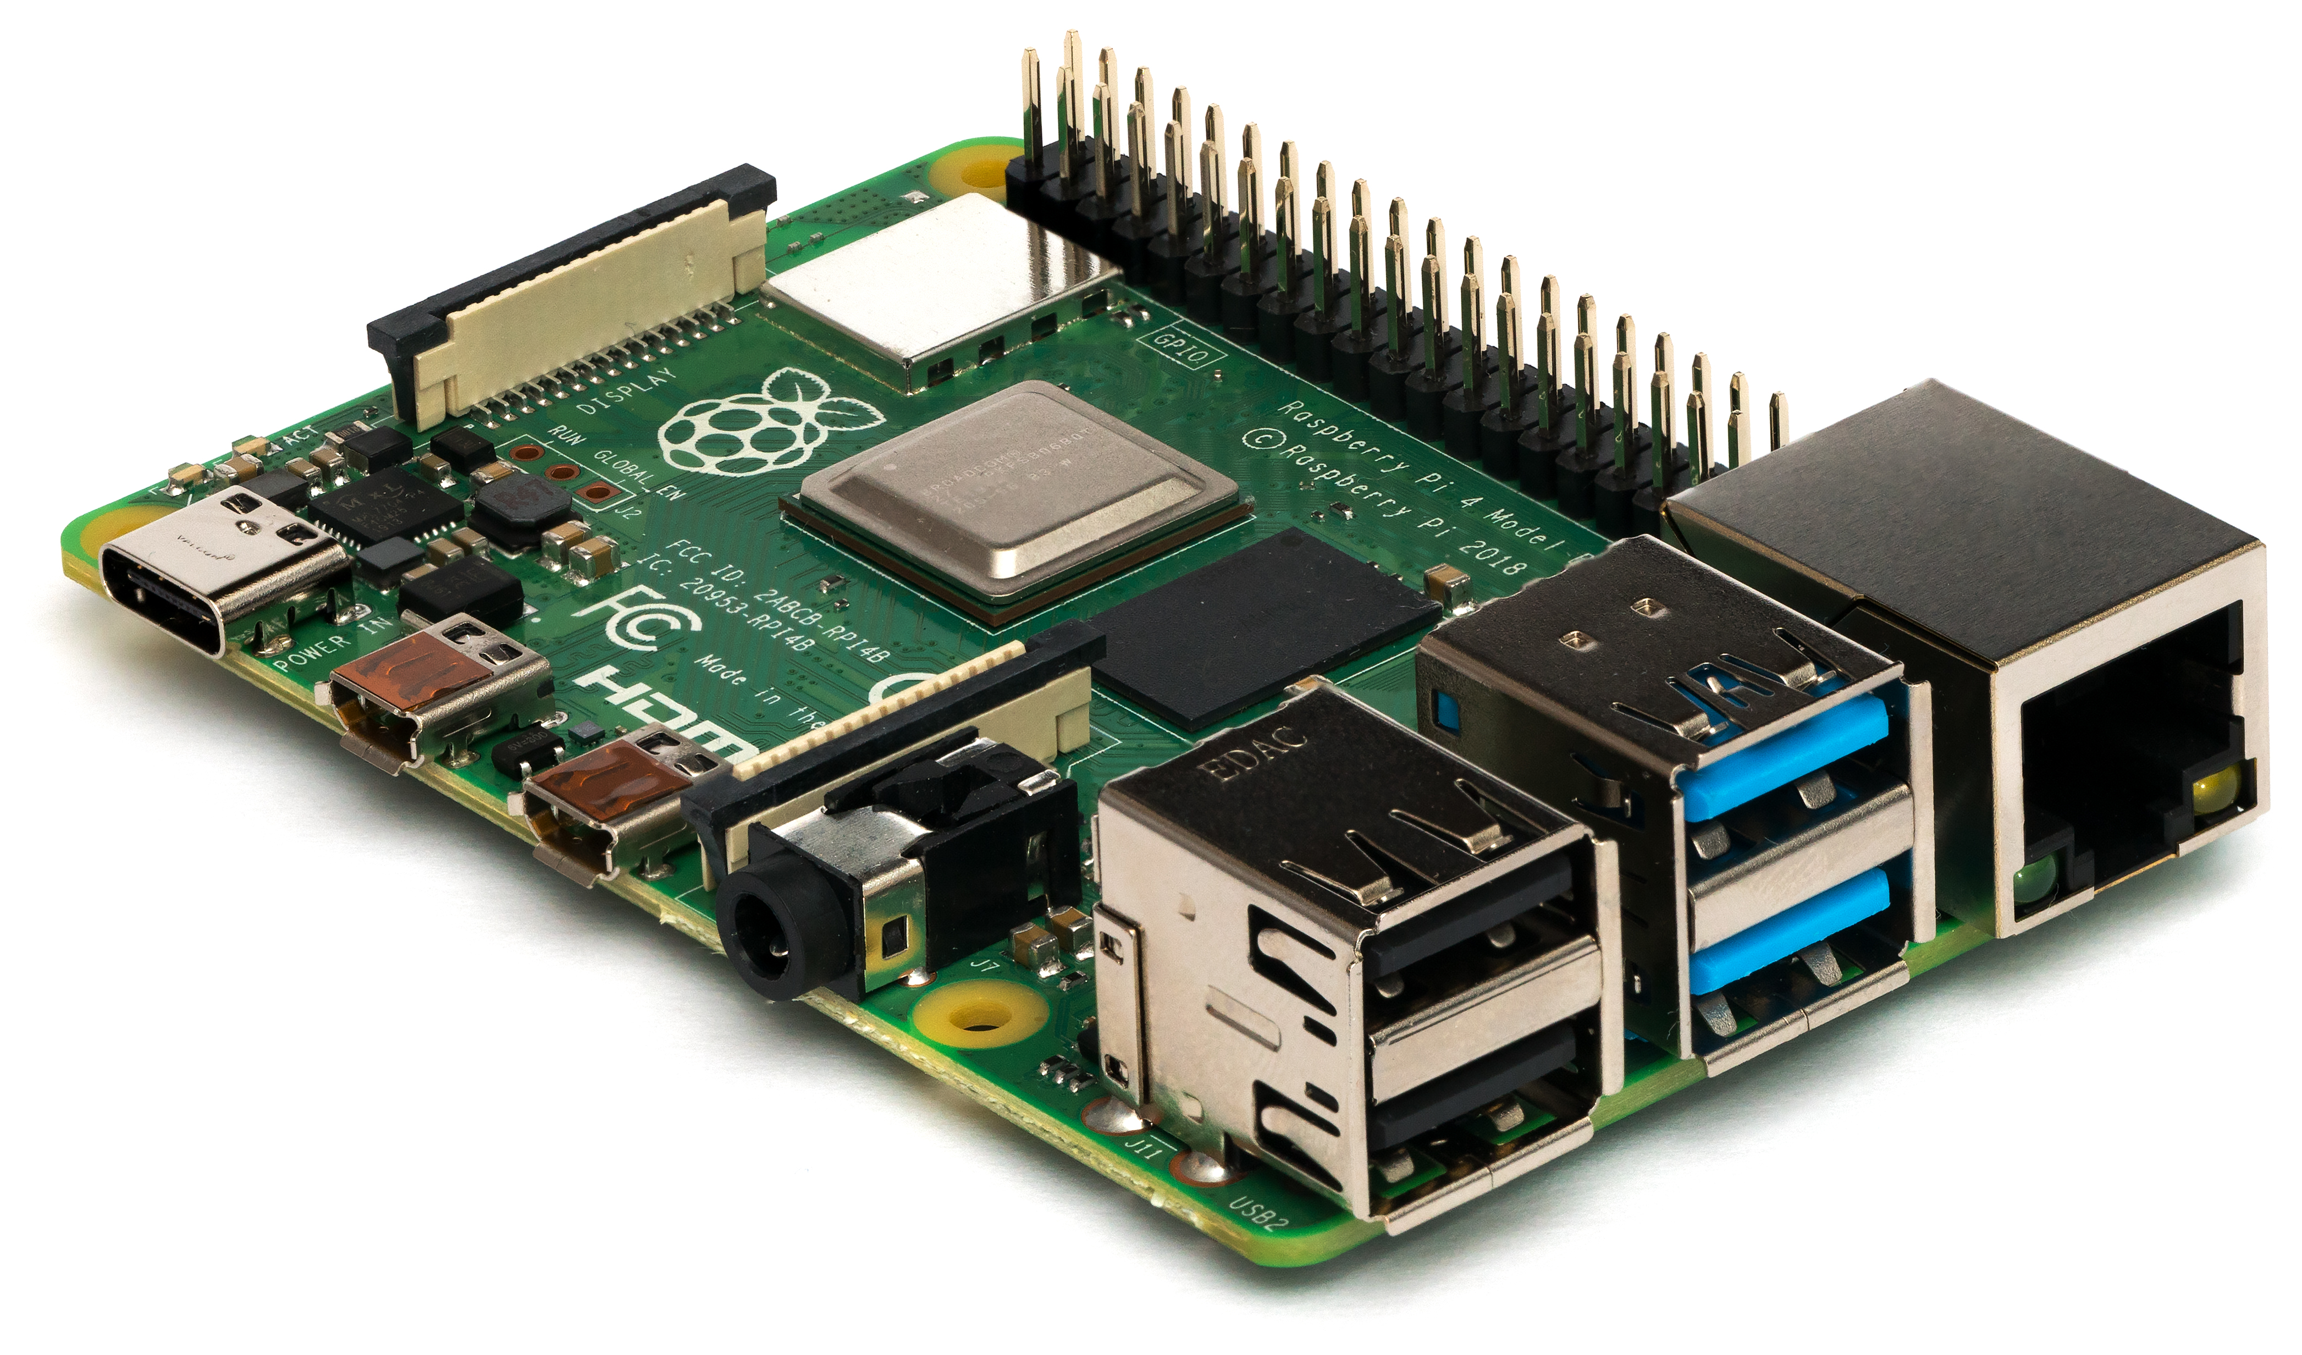
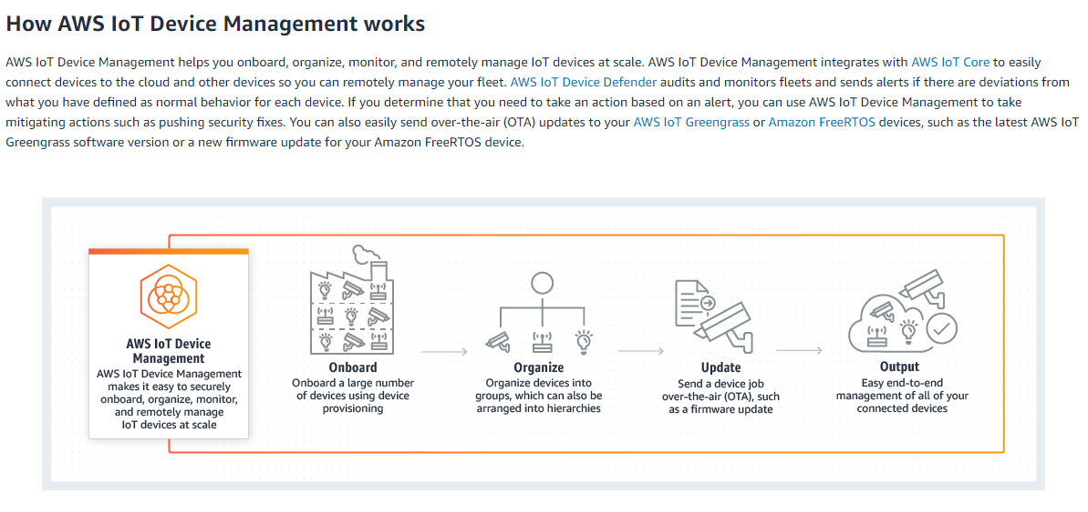
We Need Better Data… …and more Pi
More information about temperature, pressure, and wind velocity

Slide 11
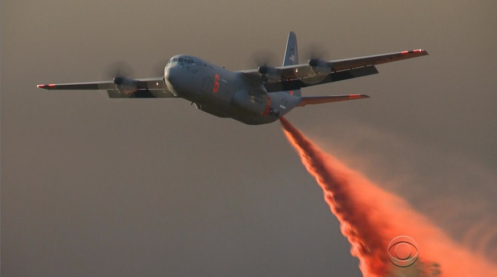

We Need Better Data…
More information about temperature, pressure, and wind velocity

Slide 12
We Need Better Data…
More information about temperature, pressure, and wind velocity

